Slide 1

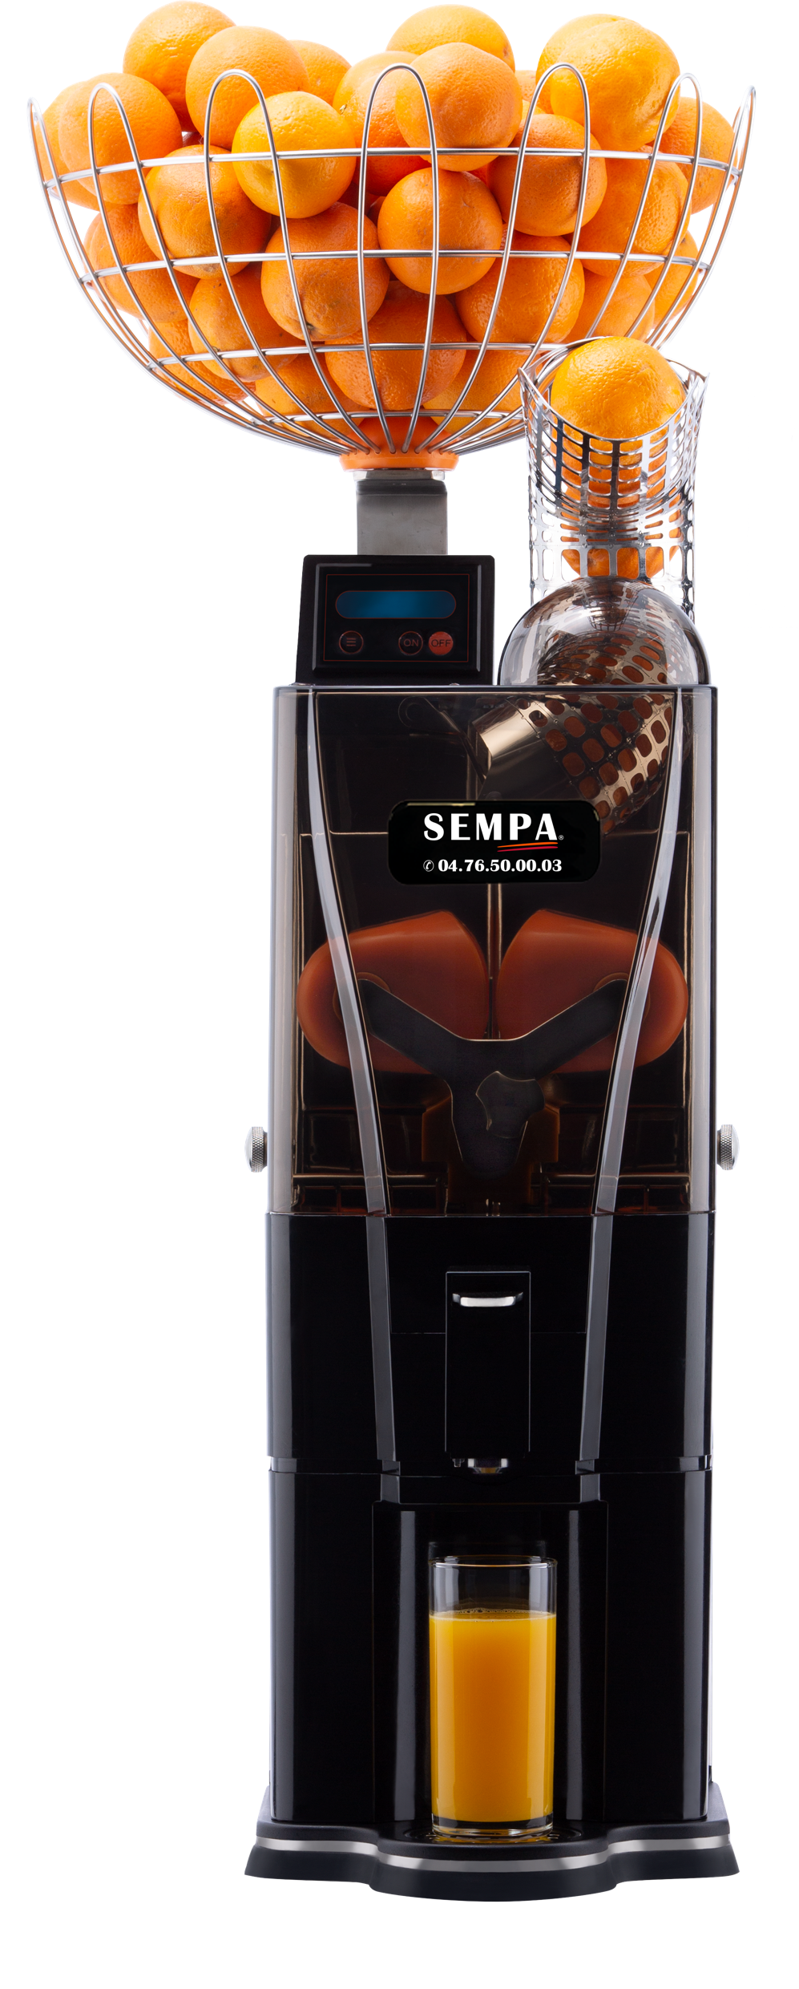
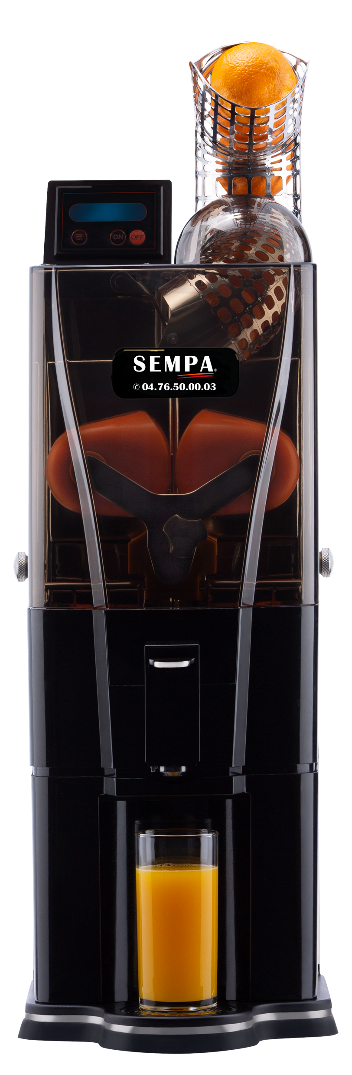
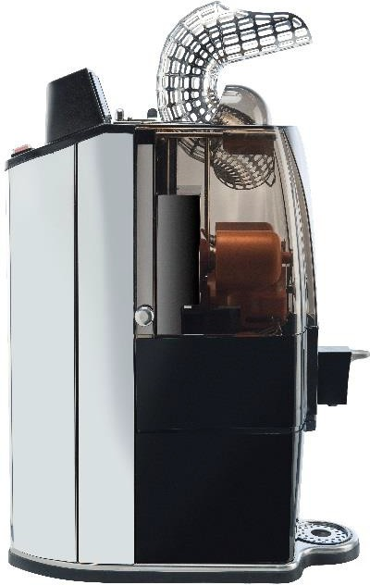
EN
Original instruction manual
- translated from the German instruction manual
Instruction Manual
Juicer | OL 41 Advance | Art. No. 10.000
Version 04-Advance
02.01.2020
When ordering spare parts, be sure to mention machine type, article and serial number.
SEMPA - 73 D rue Général Mangin 38100 Grenoble - Tél. 04.76.50.00.03 - Email : info@sempa.fr
This document is not contractual, SEMPA reserves the right to modify its products in order to better satisfy its customers.VT-V1/05-2021

Slide 2
Content
1. IMPORTANT GENERAL INFORMATION 3
1.1. Safety instructions 5
2. TECHNICAL SPECIFICATIONS 5
3. OPERATION INSTRUCTIONS 6
3.1. FIRST STEPS 6
3.2. Language selection. 8
3.3. OPERATION OF THE MACHINE 9
3.3.1. Operation of Sempa OL 41 10
3.3.2. Continuous-Mode 11
3.3.3. Intelligent Stop-Function 12
3.3.4. Display lock/unlock function 14
3.3.5. Cleaning positions (High- & Low position) 15
3.3.6. Display-Function | pressed fruits 16
3.3.7. Display-Function – Operating time 16
3.4. CLEANING INSTRUCTION 18
5. TROUBLESHOOTING 25
5.1. Emergency case – resetting 26
5.1.2. Emergency case - resetting 27
6. CERTIFICATES 28
7. IMPORTANT SPARE PARTS 37

Slide 3
1. IMPORTANT GENERAL INFORMATION
This manual refers to the following model from OL 41 :
Art.No.: 10.000 OL 41 Advance Version 04
The technical data of the Sempa commercial Orange juicers (tension, frequency and other data) is located on the identification plate, which is both on the back page of this operating/instruction manual as well as on the equipment itself.
This unit can be used by children aged 8 years and above and persons with reduced physical, sensory or mental capabilities or lack of experience and knowledge when they have been given supervision or instruction concerning the safe use of the device and understand the resulting risks. Do not let children play with this device. Cleaning and user maintenance must not be carried out by children without supervision.
If the supply cord is damaged, it must be replaced by the manufacturer, its service agent or similarly qualified persons in order to avoid a hazard.
Protective clothing, protective equipment is not necessary for the operation and operating the machine.
For all technical questions, please refer to your official dealer or official customer service representative and mention the article and serial number of your machine which can be found on the rear side of the machine.
Clean all areas and parts of the machine which come into contact with fruit or juice before initial operation as shown in the cleaning instruction.
Before cleaning the machine, making any repairs or maintenance, it is obligatory to follow these instructions:
Operate machine until no more fruits are left in the pressing area.
Switch off machine according to specification of the instruction manual (depending on the machine type: by automatically stop, by pushing ON/OFF button of the machine or by releasing SB tap) and remove all remaining fruits or parts of the fruits manually of the pressing area and/or machine.
Finally switch off main power of the machine and unplug machine from power supply.
SEMPA meets the necessary measures for a selective disposal of the devices brought on the market and provides for an environmentally friendly subsequent treatment. Please dispose of your machine in a proper way by contacting your official dealer/supplier.
Our machines are certified and in accordance with the GS and TUV safety standards.
Before operating the machine for the first time, we ask you to please read the instruction manual carefully.

Slide 4
For safety reasons, only authorized personal are allowed to make any repairs or changes on the machine. Also, no protection or safety equipment is to be changed, removed or tampered with.
Due to the fact that no adjustments on the machine are necessary, we ask you to not open the inside of the machine at any time.
Only authorized service technicians are permitted to make any repairs to the inside of the machine.
In case of damage to the machine, we ask you to either contact SEMPA directly or contact your dealer who supplied you with the machine.
Before cleaning the machine, always unplug the machine from its power supply
Only use original spare parts and accessories from SEMPA.
We give our best effort to provide you with a maximum amount of information in this document. Should you need further information, we ask you to contact us or your dealer. We will be glad to answer any questions you may have.
In our constant efforts to better our products, we reserve the right to make any changes to this instruction manual without prior notice.
In principle, a regular maintenance of the machine, for trouble-free operation, is not necessary. However, we recommend a preventive annual maintenance perform by SEMPA employees.
Should you have any suggestions to improvement, questions or comments, please feel free to contact us with the contact information provided below:
Contact: + 33476500003
Email: info@sempa.fr
Website: sempa.fr
Care is needed when handling the cutting blade during cleaning.
The machine must not be cleaned with a water jet.
Information for the correct disposal of this product:

Slide 5

 | This marking indicates that this product should not be disposed with other household wastes throughout the EU. To prevent possible harm to the environment or human health from uncontrolled waste disposal, recycle it responsibly to promote the sustainable reuse of material resources. To return your used device, please use the return and collection systems or contact the retailer where the product was purchased. They can take this product for environmental safe recycling.
Safety instructions
To ensure proper operation and to avoid damage to the machine, please observe the following points
The fastening screws of the cross holder cannot be loose or missing.
Do not place any foreign objects in the machine as this may cause unnecessary damage.
Should machine blockage occur, it is important to disconnect the machine from its power supply, only then is the front cover to be removed in order to remove orange peels.
Never try to remove blockages while the machine is operating. This could lead to serious injury.
Due to the fact that the peel removers and the knife are important functional parts of the machine, ensure that these parts are mounted carefully and correctly.
2. TECHNICAL SPECIFICATIONS
MODEL | OL 41 Advance
Oranges per minute | 15 pcs./min
Measurements (H x B x T in cm) | 77 x 24 x 51,2 cm
Net weight (in kg) | 43 kg
Power supply | 230 V / 50 Hz
Power | 280 Watt
Fuse Protection | IPx1
Optimum fruit size | 65 to 78 mm

Slide 6
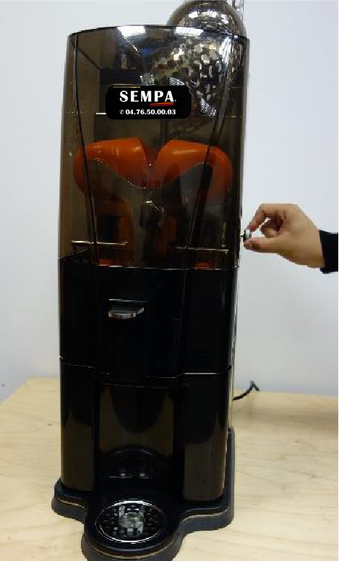
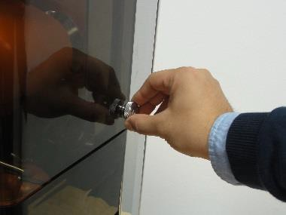
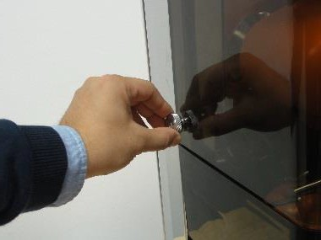
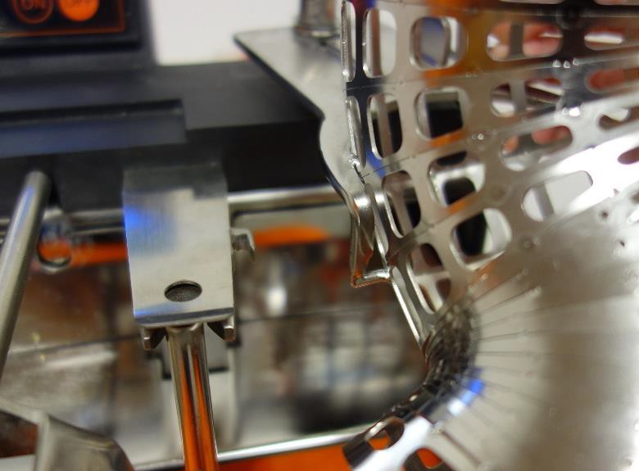
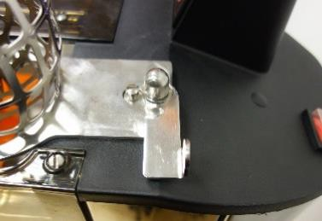
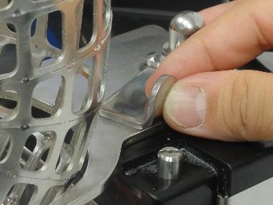
OPERATION INSTRUCTIONS
FIRST STEPS
In order to achieve an optimum operation of the machine, please follow the below-mentioned steps carefully.
After unpacking and positioning the machine on a level surface, remove the front cover by unscrewing the 2 fastening screws shown in pic. 1. Lift the front cover out of its anchoring to expose the pressing system.
R
L
Picture 1: front cover fixation screw
Attach the supply tunnel by first fixing the hook on the left side, placing the mounting plate on the rear and secure the fixation lever (see pic 2).
Picture 2: lever fruit supply tunnel

Slide 7
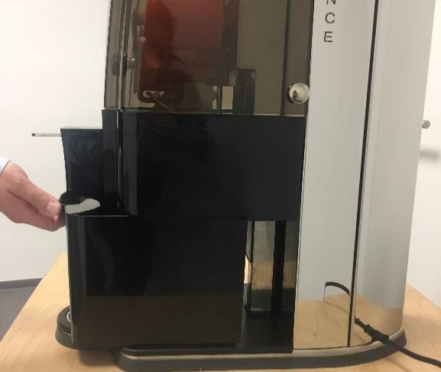
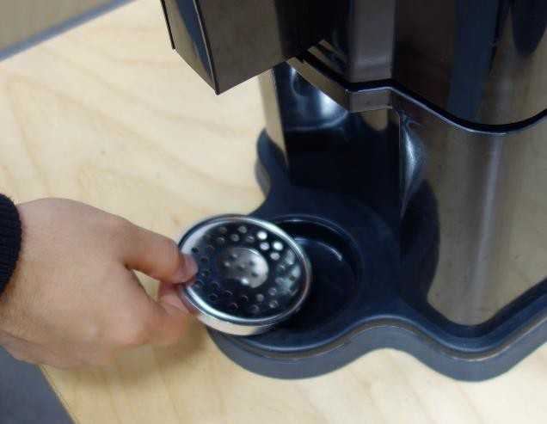
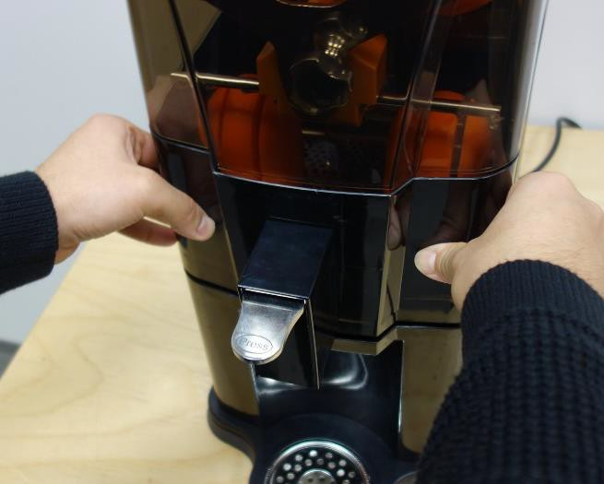
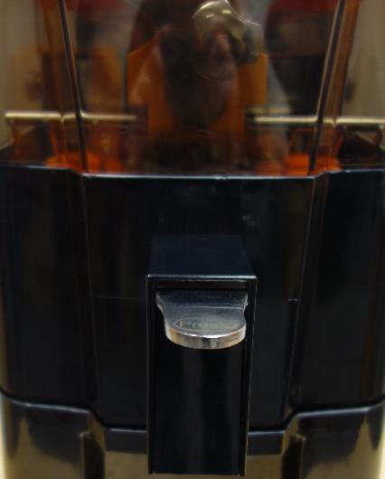

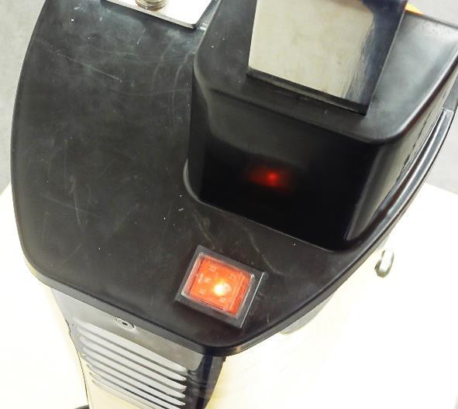
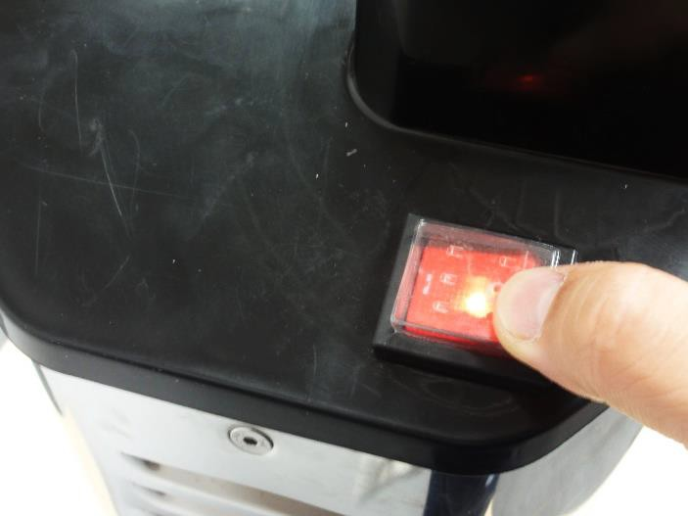
Place the peel basket (pic. 3) and the drip cup as shown (pic 4).
Picture 4: Peel basket Picture 3: trip tray
Make sure that the fruit sieve support (inclusive fruit sieve) is in its proper position and the front cover is closed. (siehe pic. 5 und pic. 6)
Picture 6: Frontabdeckung geschlossen
Picture 5: Fruchtschale
Ensure that the voltage is identical with that shown on the identification plate.
Plug the machine into a standardized and grounded power supply socket. Switch on the main power switch located at the top of the machine. (Red control lamp lights up, see pic. 7)
Picture 7: main switch

Slide 8
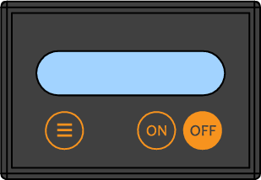
Language selection
It is possible to choose between 5 different display languages:
English
German
Spanish
French
Italian
Please follow the points below, to choose your required display language:
Pic. 8: Switch on the main power switch located at the top of the machine. The control lamp lights up.
Pic. 9 No. 1: Select with the FUNC-Button the menu item “Choose language”
Pic. 9 Nr. 2 & 3: Select your required language by pressing the ON and OFF-Button together.
Pic. 9 Afterwards select with the FUNC-Button the required menu item. Due to this fact the display language is stored.
Picture 8: main switch
Choose language
English
1
Picture 9: display language selection
2 3

Slide 9
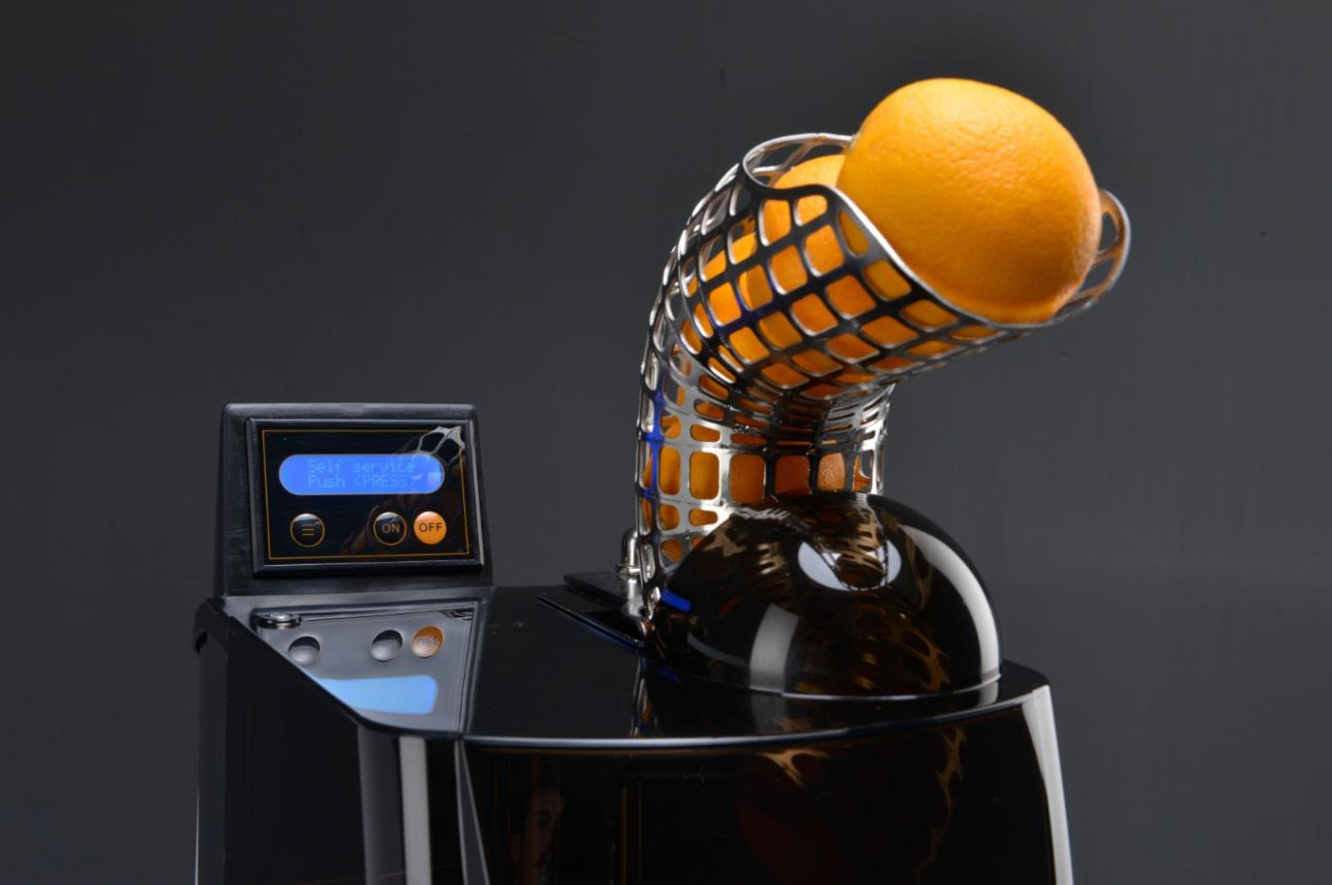

OPERATION OF THE MACHINE
Fill the supply tunnel with oranges. To make sure that the machine works properly, use fruits between 65 – 78 mm in diameter. (pic. 10)
min. Ø 65 mm max. Ø 78 mm
Picture 10: fruit supply tunnel

Slide 10
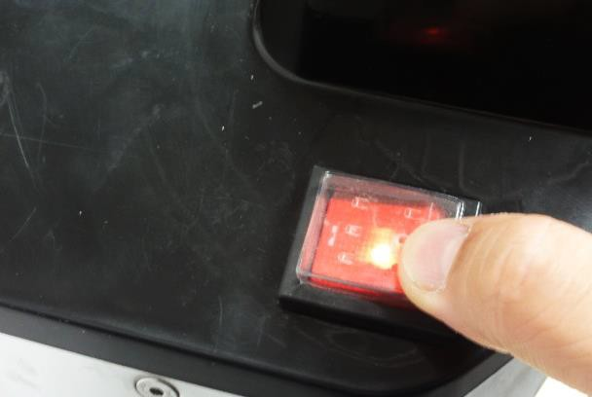
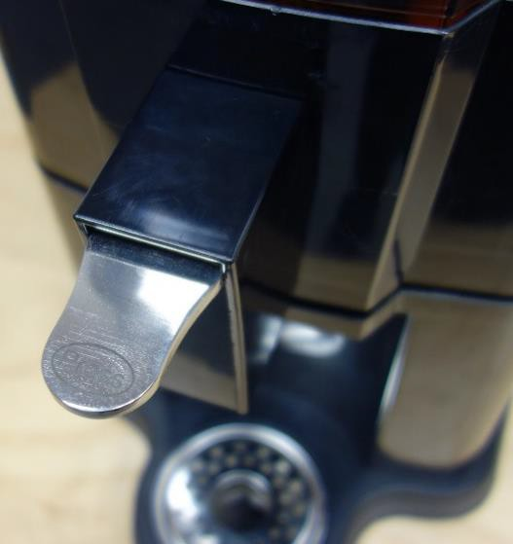
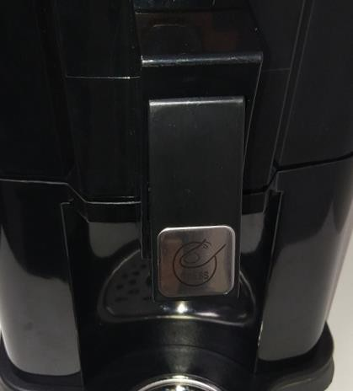
Operation of SEMPA OL 41
Place a glass or another container under the juice outlet. To begin the pressing procedure, follow the instructions mentioned below:
Self-Service Mode:
Pic. 11: Switch on the main power switch located at the side of the machine. The red control lamp lights up.
Pic. 12 No. 1 FUNC button: Select the self-service mode by pressing this button. „Self-service Push “Press”“ is indicated on the display.
Pic. 13: Stop and start the machine by pressing the self-service button. (SB-Tap)
Picture 11: main switch
Self Service Push <PRESS>
1
Picture 12: Display – self service mode
Picture 13: self - service tap old and new

Slide 11
3.3.2. Continuous-Mode
Pic. 14: Switch on the main power switch located at the top of the machine. The red control lamp lights up.
Pic. 15 No. 1 FUNC button: Select the continuous mode by pressing this button. „Continuous Push “ON” is indicated on the display.
Pic. 15 No. 2 ON button: Start pressing (continuous mode)
Pic. 15 No. 3 OFF button: Stop pressing (continuous mode)
Picture 14: main switch
Continous
Push <ON>
1
Picture 15: Continuous mode
2 3

Slide 12
Intelligent Stop-Function
With this function you can adjust after which number of fruits the machine should stop. An acoustic signal indicates when the peel bucket is full and need to be emptied. Please follow the description below:
Pic. 17: Switch on the main power switch located at the top of the machine. The control lamp lights up.
Pic. 17: No.1: Select the function “Empty bucket after “xx” oranges” with the FUNC-button
Pic. 17: No.2/3: Adjust the amount of oranges after the machine should stop with the ON- button + and OFF-Button -.
Start the machine in the desired mode.
As soon as the machine has reached the adjusted amount of oranges, it stops, peeps 5 times and will be locked!
Pic. 17: No.3: To unlock the machine empty the peel bucket and press the OFF-Button for 5 sec.
Afterwards the machine can be started again.
Picture 16: Main switch
Empty peel bucket after 15 Oranges
1
Picture 17: Display – intelligent stop
2 3

Slide 13

Attention:
Switch off intelligent stop function
To switch off the intelligent stop function please adjust to 00 oranges!
Switch on intelligent stop function (adjusted orange changed from 00 – XX)
Adjust the amount of pressed oranges – start the machine and press one orange – Machine stops automatically – Press OFF-button 5 sec – amount of oranges is saved!
Recommended adjustment regarding the intelligent stop function:
Peel bucket | Recommended adjustments
Standard peel bucket | 15 oranges
Peel bucket countertop installation | 130 oranges

Slide 14
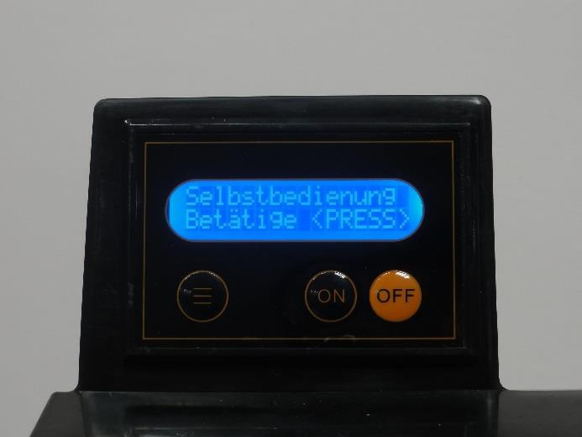
Display lock/unlock function
It is possible to lock the display that the adjusted mode cannot be changed unintentionally. Please find the description below:
Pic. 18: Switch on the main power switch located at the top of the machine. The control lamp lights up.
Picture 18: main switch
Adjust the desired display function (pic. 19, No.2)
Press the OFF-Button + FUNC-Button -> Display locked (pic. 19, No.1+2)
Self Service Push <Press>
2
1
Picture 19: Display – lock function
1
2
The display is locked and the adjusted mode cannot be changed unintentionally. If the FUNC- button is pressed the display shows how to unlock the display - “Unlock key panel Push OFF & FUNC”!

Slide 15
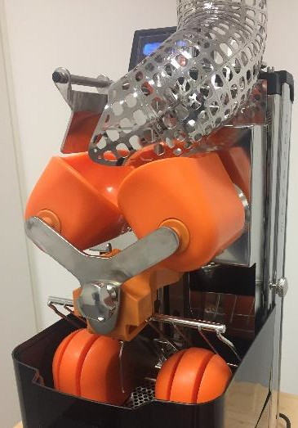
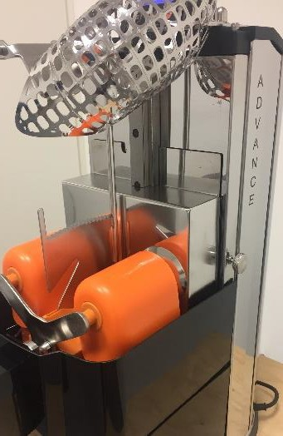
Unlock key panel Push OFF & FUNC
1
Picture 20: Display – unlock function
2
Unlock display
Press the FUNC-Button + OFF-Button → Display unlocked (pic. 20, No.1+2)
3.3.5. Cleaning positions (High- & Low position)
Push <ON> Push <OFF>
TOP
Lower
1 2
Picture 21: Display – cleaning position
Picture 22: High-position
Picture 23: Low-position
Choose with FUNC-Taste “Push <ON> Top Push <OFF> Lower” (pic. 21, No.1).
Press the ON-button (No. 1) to set machine to the high-position (pic. 22).
Press the OFF-button (No. 2) to set the machine the low-position (pic. 23).
Front Cover, fruit sieve support and peel bucket need to be assembled to set the cleaning positions!

Slide 16
Display-Function | pressed fruits
Pic 24 No. 1 FUNC button: Press this function button to indicate the total number of pressed fruits.
Total squeezed Fruits
116
1
Picture 24: Display – fruit counter
Display-Function – Operating time
Pic. 25 No. 1 FUNC button: Press this function button to indicate the total operating time.
Operating hours
Total
22h 1m
1
Picture 25: Display – operating hours

Slide 17
Factory mode (only for technicians)
The factory mode is used to adjust different parameters of the machine. This function should only be used from technician and is locked with a password.
To skip the factory mode, press the FUNC-Button (pic. 26, No. 1)
Factory Mode
Password
000
1
Picture 26: Display - Factory Mode

Slide 18
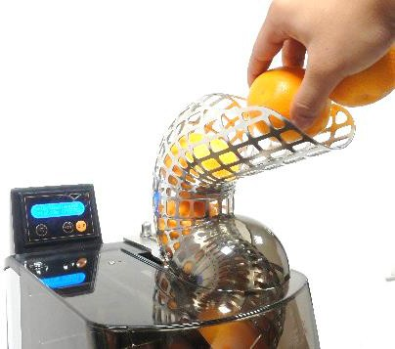
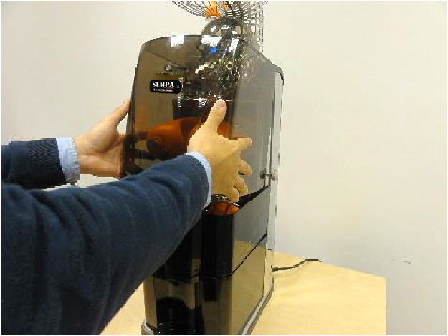
3.4. CLEANING INSTRUCTION
In order to clean the machine properly, please follow the instructions below:
The below-mentioned cleaning steps are to be completed at least twice every 24 hours.
IMPORTANT: Before cleaning the machine, ensure that the machine is disconnected from power (unplug the machine).
 | 1. Either press the oranges remaining in the supply tunnel or remove them by hand.
 | 2. Loosen the front cover screws (left and right).
 | 3. Remove the front cover: Pull the lower part of the front cover slightly towards the front. Then lift the cover away from the retaining bolts. Clean the hood with water (30 – 50°C) and a cleaning cloth to remove any juice and fruit pulp residues. Rinse thoroughly with water (30 – 50°C). Dry with disposable tissues. CAUTION: Do not clean in a dishwasher!

Slide 19
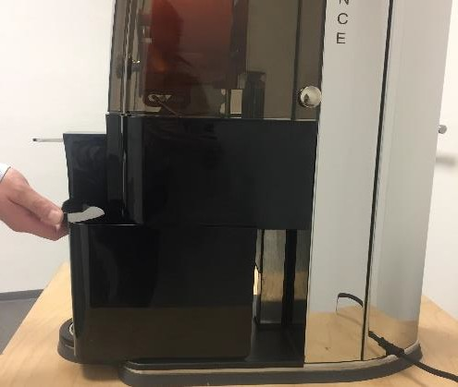
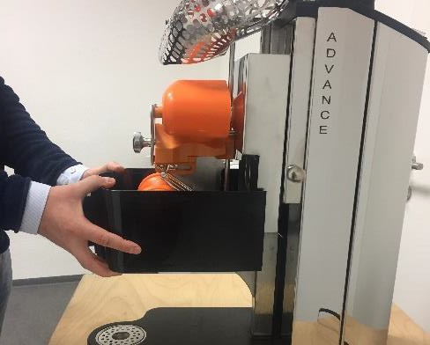
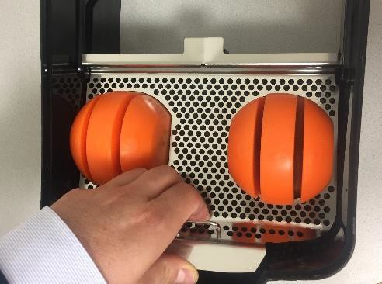
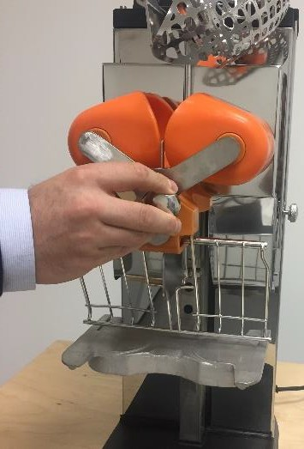
4. Remove the peel bucket.
5. Pull out the fruit sieve support and take out the fruit sieve.
6. Unscrew the Cross Holder screw.

Slide 20
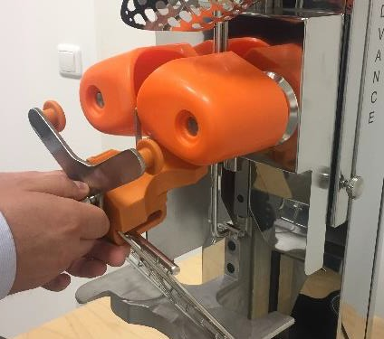
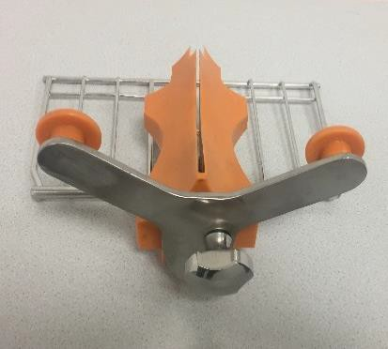
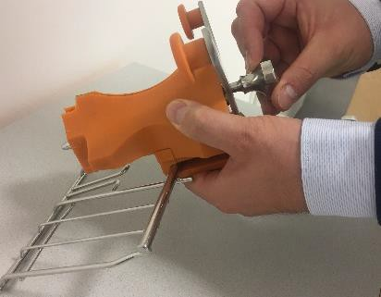
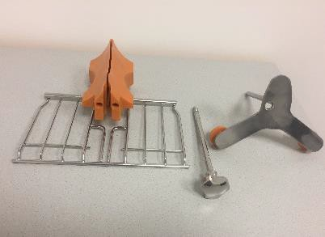
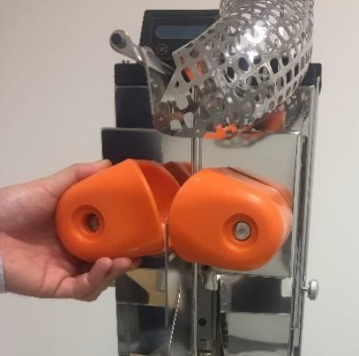


 | 7. Pull out the Cross Holder.
 | Separate the knife guide from the cross holder by pulling out the cross holder screw. (3 individual parts: cross holder, knife guide, screw) Caution: When reinstalling the knife make sure that it rests in the correct position and that the screw is properly tightened by hand. In case of disregard, either the blade system or the upper pressing units of the machine might get damaged. Remove the upper pressing elements (right and left)

Slide 21
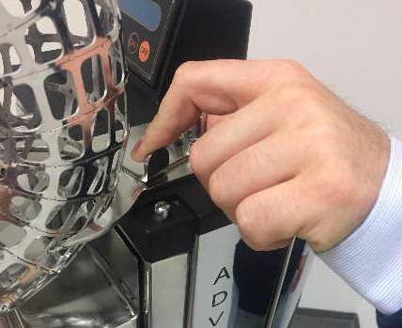
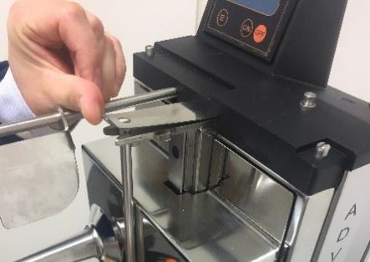
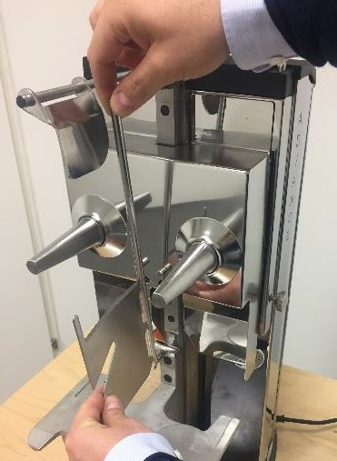
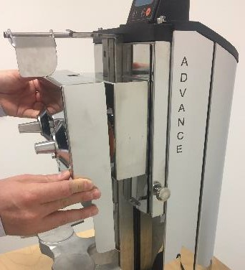
 | 10. Unclamp the fixation lever of the feeder and remove the supply tunnel.
 | 11. Remove the knife by pressing the fastening tab up and then lift it out of the anchorage.
 | 12. Remove the front plate/ Double Cover

Slide 22
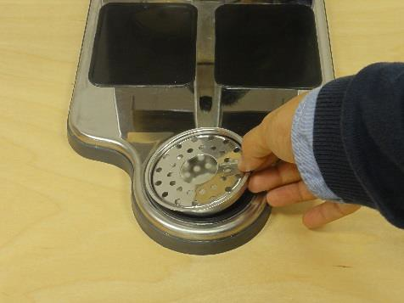
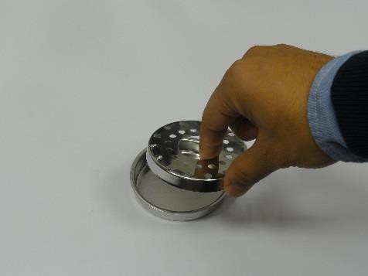
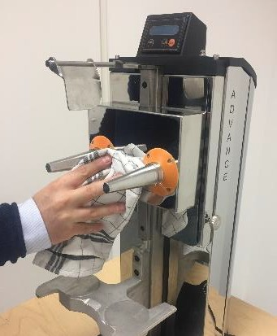
 | 13. Remove the drip cup and the sieve from the cup.
Place all mentioned parts (with the exception of the acrylic front cover) in a dishwasher or clean them thoroughly by hand!
 | 11. Clean the housing. The machine must not be cleaned by means of a water jet but with a wet cloth and clear water only. Wipe clean with a cleaning cloth and dry with a disposable tissue
Re-Mount all parts after cleaning in the opposite order of removal.
Ensure that all parts are correctly mounted and tightened! We recommend cleaning the machine twice within 24 hours.
PLEASE NOTE:
DO NOT clean the acrylic front cover in the dishwasher. Cleaning the front cover is to be done by hand with warm water and disposable drying tissues.
DO NOT use any abrasive materials or decalcifying agents.

Slide 23
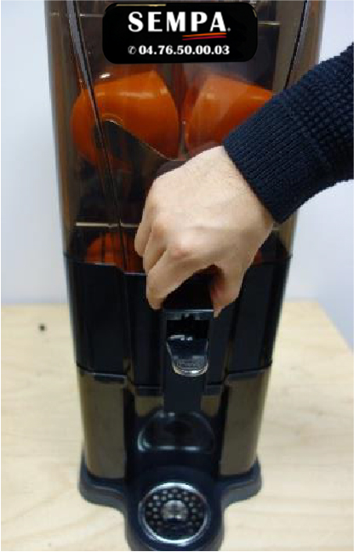
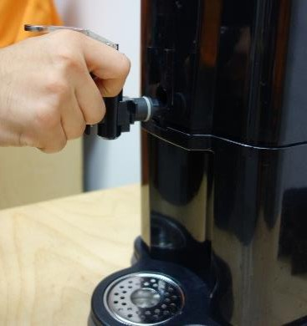
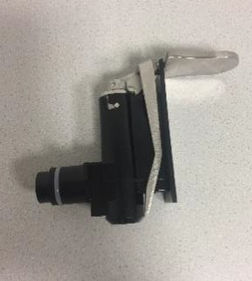
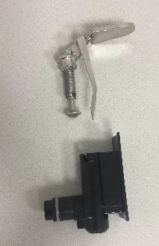
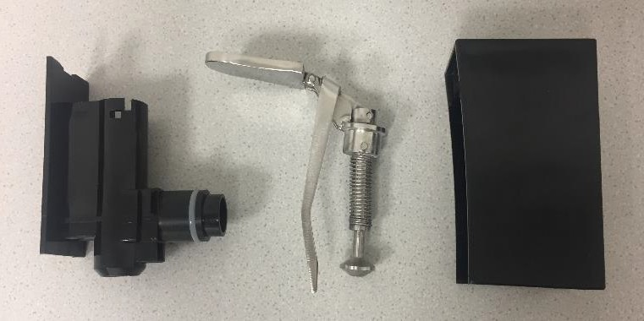
Cleaning of the Self-Service Tap (SB-Tap)
 | 1. Please remove SB-tap housing by pulling it up.
 | 2. Pull the tap completely out.
 | 3. Turn the tapping lever to the left and pull it out upwards.
Dishwasher cleaning of all parts possible!

Slide 24
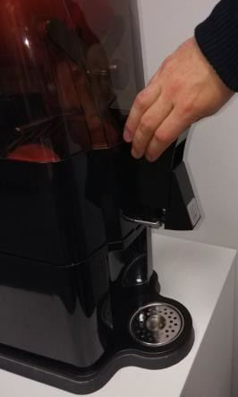
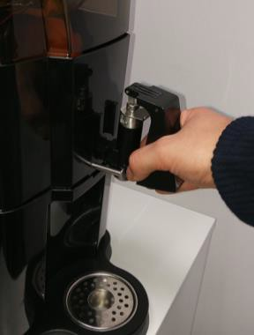
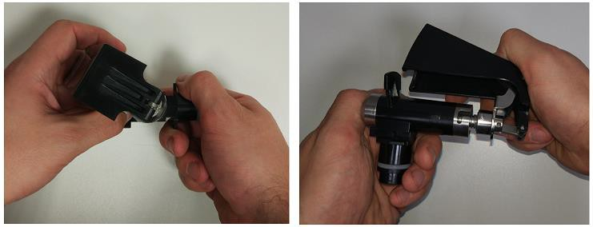

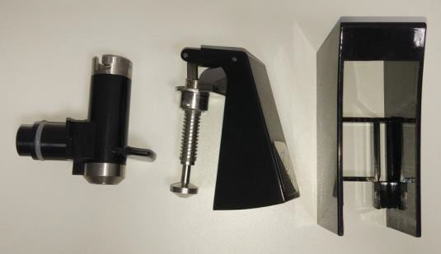
Cleaning of the Self-Service Tap (SB-Tap) new version from 06.11.2019
 | 1. Please remove SB-tap housing by pulling it up.
 | 2. Pull the tap completely out.
 | 3. Turn the tapping lever to the right and pull it out upwards.
Dishwasher cleaning of all parts possible!

Slide 25
5. TROUBLESHOOTING
PROBLEM | POSSIBLE CAUSE | SOLUTION
The machine is not working | Check if machine is plugged into power outlet | Connect to power source
 | No electricity from power outlet | Check the power outlet for electricity
 | Main switch off | Check if main switch on the side of machine is switched on.
 | ON/OFF switch damaged | Contact your customer service representative.
 | The press elements are blocked | Unplug the machine from its electricity source and remove the object which is blocking the machine in the press elements.
 | Safety detectors are damaged. | Contact your customer service representative.
 | Switching circuit is damaged | Contact your customer service representative.
Display shows “End position“ | Magnet switch for the end position is damaged | Contact your customer service representative
Display shows “Feeder tube“ | Feeder tube/Inlet tunnel mounted incorrectly | Mount the Feeder tube/Inlet basket according to the instruction manual.
Display shows “Fruit sieve supporter” | Fruit sieve supporter mounted incorrectly. | Mount the fruit sieve supporter according to the instruction manual.
Display shows “Front cover” | Front cover mounted incorrectly. | Mount the front cover according to the instruction manual.
Display shows “Peel Bucket” | Peel Bucket mounted incorrectly. | Mount the Peel Bucket according to the instruction manual.
Display show an error message, although all parts are mounted according to the instruction manual. | Security-Magnet is loosen or the magnet switch is damaged. | Contact your customer service representative.
The machine has blocked often during the pressing process. | Power supply voltage is insufficient. | Check if the power supply coincides with that which is mentioned in the instruction manual.
 | Switching circuit damaged | Contact your customer service representative.
Press elements are not synchronized | Gear wheel or axle is damaged | Contact your customer service representative.
You can hear the motor but the press elements are not turning. | Malfunction inside the machine | Contact your customer service representative.
The machine stops running periodically | Overload | Contact your customer service representative.
The machine stops often DISPLAY: OVER | Overload | Contact your customer service representative.

Slide 26


5.1. Emergency case - resetting
In case of blockage of the machine (due to incorrect installation to hard or frozen fruit), there will
occure “Overload consult machine” on the display.
Please consider the following steps in the resetting of the machine:
Pic. 27: Display “Overload consult manual”
Pic. 28/29: Press ON and OFF as long as the pressing kits are in a nearly horizontally position.
Pic. 31/32: Remove the reason for the blockage and switch on and off the main switch to reset the error message.
Overload Consult manual
Overload Consult manual
1 2
Picture 28: Press ON/OFF Buttons
Picture 27: Display
Picture 29: pressing kits
Picture 30: turn off and on the main switch

Slide 27






5.1.2. Emergency case - resetting
In case of not solving the blockage of the machine with pressing the buttons, the machine can be reset via allen key.
Please consider the following steps in the resetting of the machine:
Pic. 31: Press the power switch to turn off the machine.
Pic. 32/33: Pull the allen key out of the holder that is located at the machine base. (Machine tend laterally) (a usual allen key, size 8, is also useable)
Pic. 34: Remove the round plastic cap, which is located on the backside of the machine and run the allen key pass.
Pic. 35: In order to lift the blockade of the machine, turn the conclusions in any direction.
Attention: Please put out the crank key before starting the machine!!!
Now you can switch the machine on and press the SB-tap.
Picture 31: Maschine main switch
Picture 32: Allen key fixation
Picture 33: Allen key
Picture 34: Allen keyhole Picture 275: Turning - allen key
Picture 36. Movement of pressing elements
Attention: Please do not forget do put out the crank key before starting the machine!!!

Slide 28

6. CERTIFICATES

Slide 29


Slide 30


Slide 31


Slide 32


Slide 33


Slide 34


Slide 35


Slide 36


Slide 37




7. IMPORTANT SPARE PARTS
300104010 | Front Cover OL 41 Advance Art. No.: 300104010
 | Magnet front cover complete Art. No.: 300605007 - Screw Art. No.: 300668017 - Magnet Art. No.: 300128012 - Support
300114030 | Fruit sieve support OL 41Advance Art. No.: 300114030
300117032 | Peel Container Art. No.: 300117032

Slide 38





300106012 | Fine sieve Art. No.: 300106012
300107022 | Upper pressing element Art. No.: 300107022
300108022 | Lower pressing element (fixed in the fruit sieve support) Art. No.: 300108022
300211033 | Knife Art. No.: 300211033
300226003 | Double Cover (detachable machine back wall) Art. No.: 300226003

Slide 39





300110002 | Plastic knob - Cross Holder Art. No.: 300110002
300249003 | Cross holder Art. No.: 300249003
300253003 | Cross Holder Screw Art. No.: 300253003
300109020 300246023 | Knife guide & guide of peel ejector (rake) Art. No.: 300109020 Art. No.: 300246023
300246023 | Rake (Backward peel ejector) Art. Nr.: 300246023

Slide 40





300006021 | Electronic box / Main electronics Art. No.: 300006021
300009060 | Display complete Art. No.: 300009060
300112040 | SB-Tap complete Art. No.: 300112040
 | Magnet system SB-Tap Art. No.: 300207000
300207000 | SB-Tap lever Art. No.: 300215013

Slide 41




300112050 | SB-Tap complete Art. No.: 300112050
300239043 | Fruit supply tunnel Art. No.: 300239043
300002021 | Motor Art. No.: 300002021
300203033 | Fruit sieve Art. No.: 300203033

